Slide 1
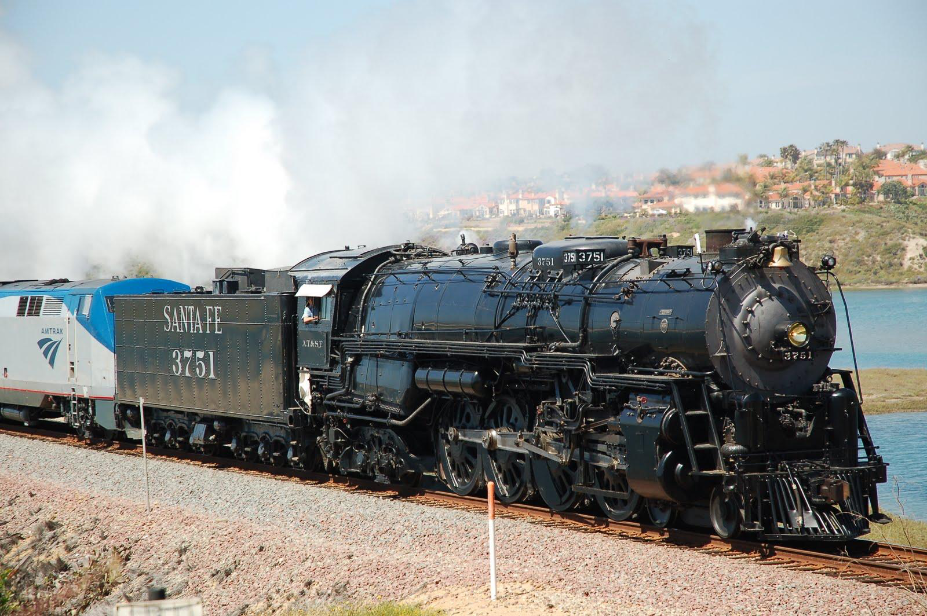
FINE-TUNING WITH KADEE
Presented by Professors:
Frank Haugh, Art Bumpus & Larry Rine

Slide 2
FINE-TUNING WITH KADEE
CLINIC OBJECTIVES
The clinic attendees will:
Drill and tap a hole to install a Kadee #5 box and
coupler and a Kadee 242 box and a #148 coupler as
demonstrated by the instructors.
Use the Kadee Coupler Height Gauge, to adjust the couplers to the correct height as demonstrated by the instructors.
Use shims to ensure that the coupler will not droop as demonstrated by the instructors.
Learn other techniques as time permits.
Apply what you have learned today to improve the operation of your other model trains, regardless of the manufacturer.

Slide 3
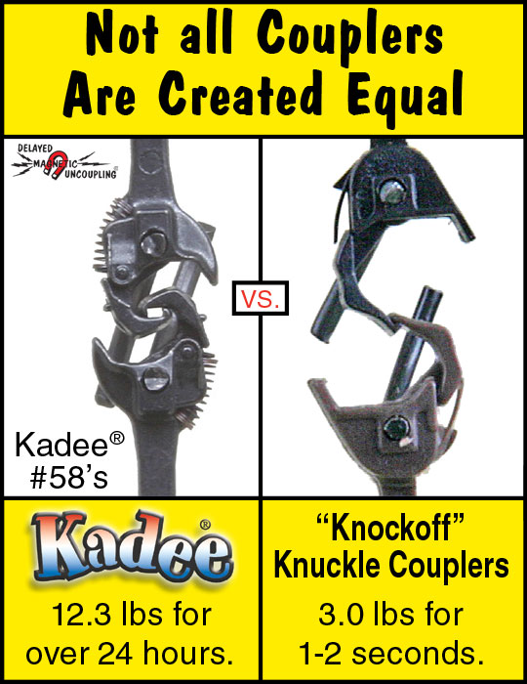
FINE-TUNING WITH KADEE

Slide 4
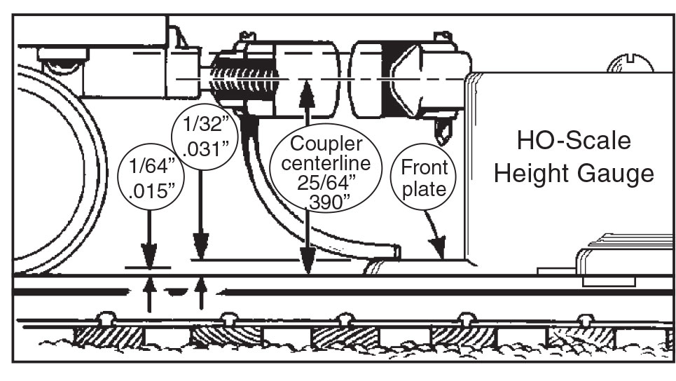
FINE-TUNING WITH KADEE
Proper Coupler Height
IS SO IMPORTANT
Use a coupler height gauge NOT another car to check coupler height

Slide 5
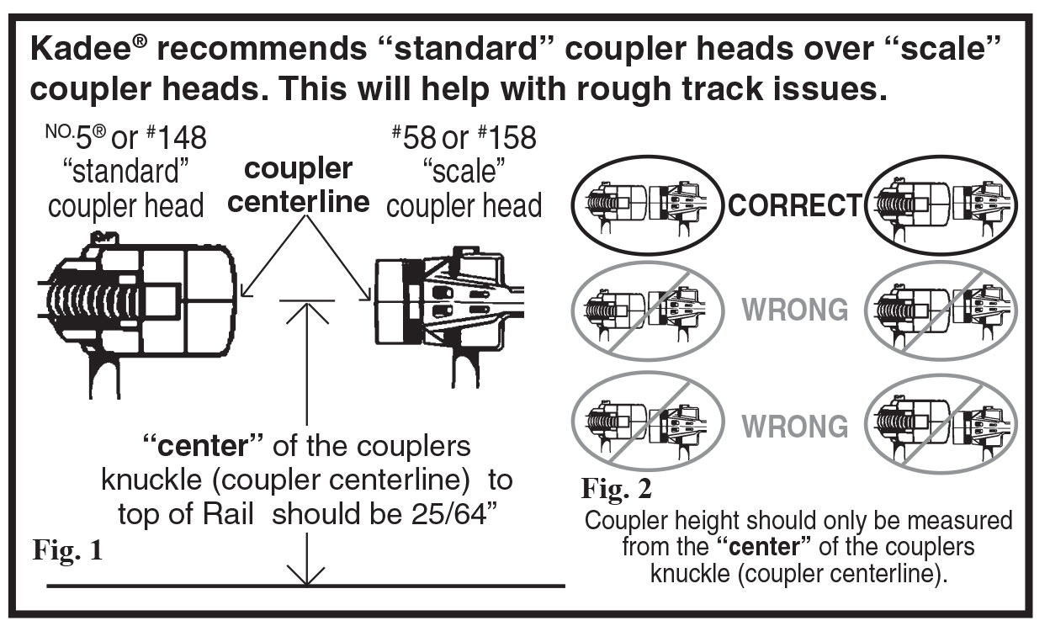
FINE-TUNING WITH KADEE
Proper Coupler Height IS SO IMPORTANT
Use a coupler height gauge NOT another car to check coupler height

Slide 6
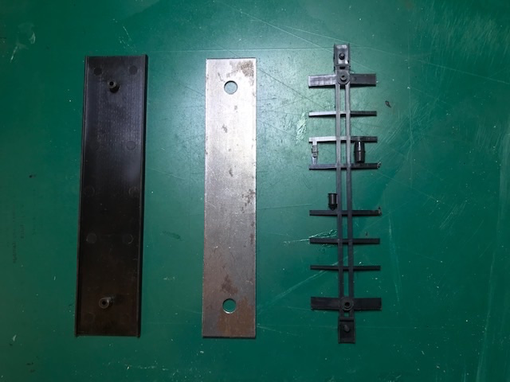
FINE-TUNING WITH KADEE
Floor Steel Weight Under Frame

Slide 7
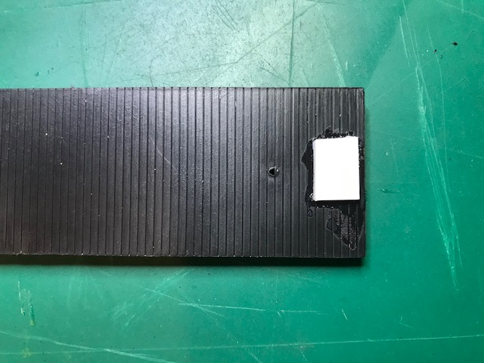
FINE-TUNING WITH KADEE
DO NOT Glue Styrene Reinforcer To Edge Of Floor!

Slide 8
FINE-TUNING WITH KADEE

Slide 9
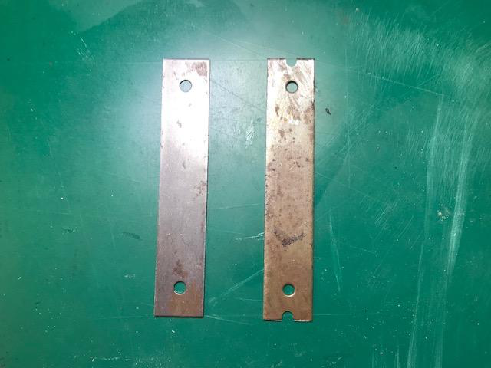
FINE-TUNING WITH KADEE
Steel Weight Comparison
The weight can be ground-out with a Dremel Tool, drilled with a Drill Press, or
Drilled with an electric drill.

Slide 10
This shows the milled/drilled weight on top of the un-milled/un-drilled Weight.

Slide 11
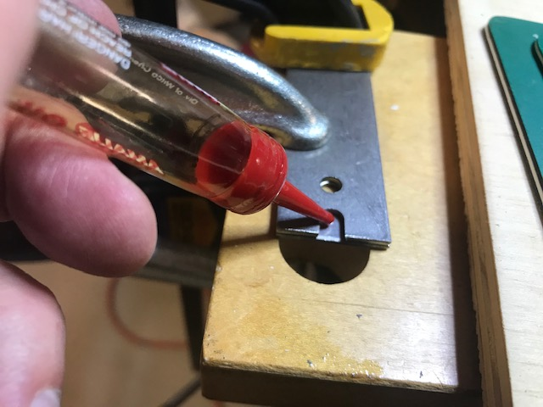
FINE-TUNING WITH KADEE
I am using the steel weight from the car you’re working on as a template to drill the new holes. Prior to drilling I have put a drop of machine oil in the area to be drilled.
This reduces wear on you’re drill bit.

Slide 12
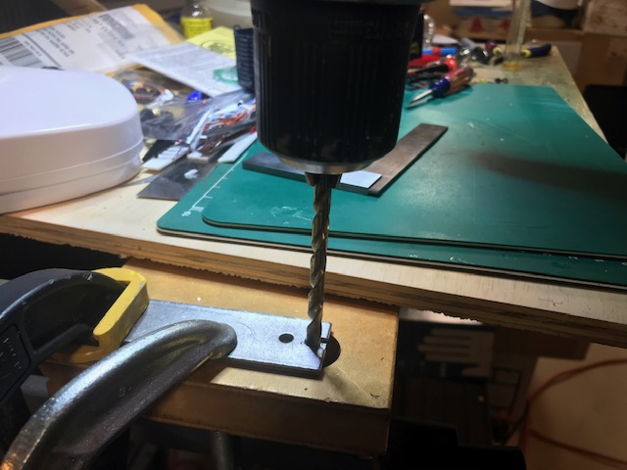
FINE-TUNING WITH KADEE
After clamping the two steel weights I am drilling a hole for the Coupler Pocket Screw. Make sure your drill bit is perpendicular to the weight. After 20 seconds of drilling, I applied another drop of machine oil.

Slide 13
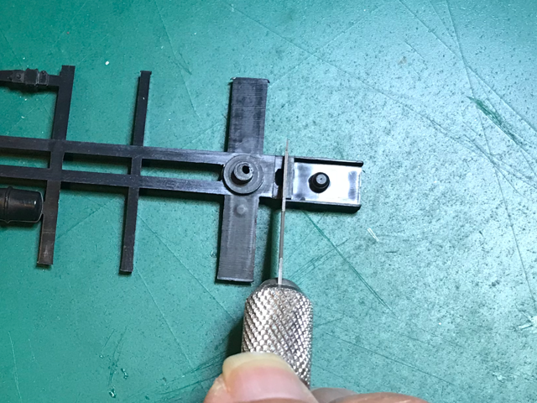
FINE-TUNING WITH KADEE
With bottom of Underframe facing you, use Exacto Knife to cut off coupler box.
Be careful to make cut perpendicular to the frame.

Slide 14
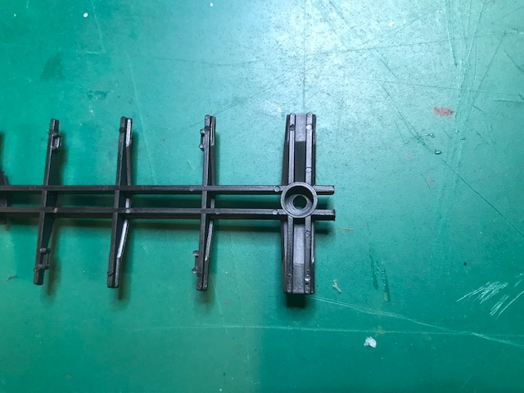
FINE-TUNING WITH KADEE

Slide 15
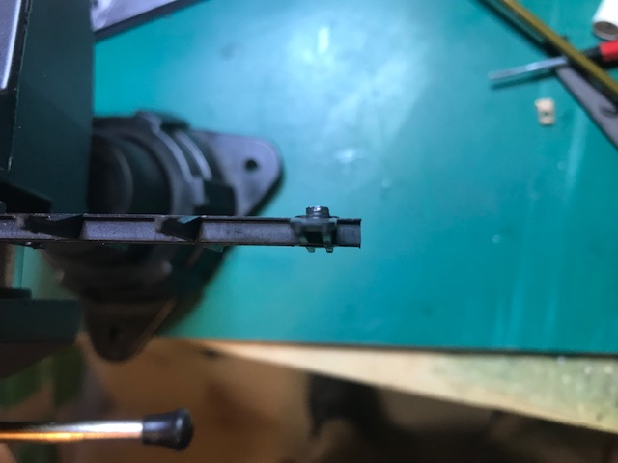
FINE-TUNING WITH KADEE
If your cut was not perpendicular, you can make it so by using your file.

Slide 16
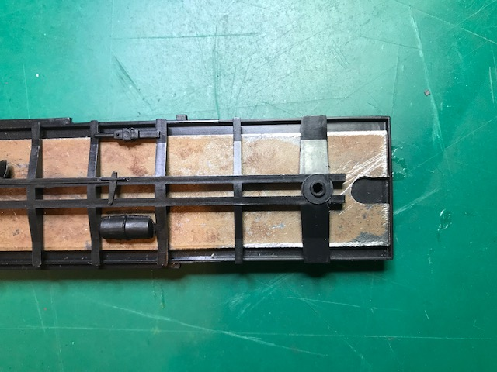
FINE-TUNING WITH KADEE
Reassemble Weight and Frame.

Slide 17
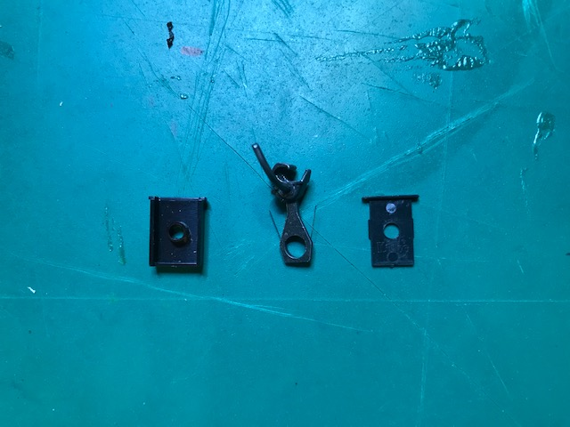
FINE-TUNING WITH KADEE
Kadee #242 Box and #148 Coupler

Slide 18
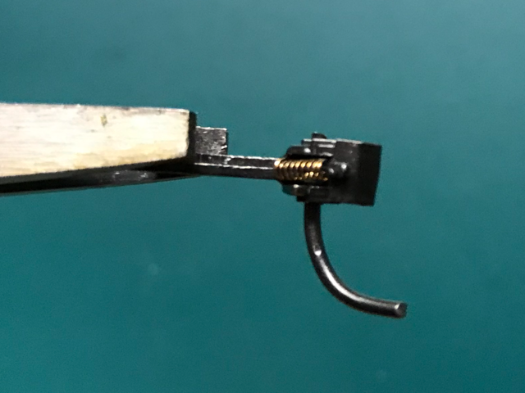
FINE-TUNING WITH KADEE
Kadee #148
Coupler Trip-Pin

Slide 19
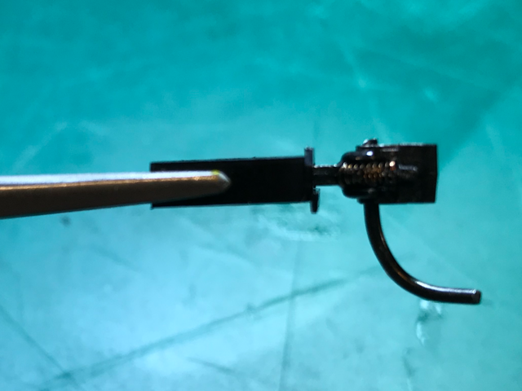
FINE-TUNING WITH KADEE
Note the Upper Lip on the Coupler Box.
You will use this Lip to align the Coupler Box to the correct depth against the car floor.

Slide 20
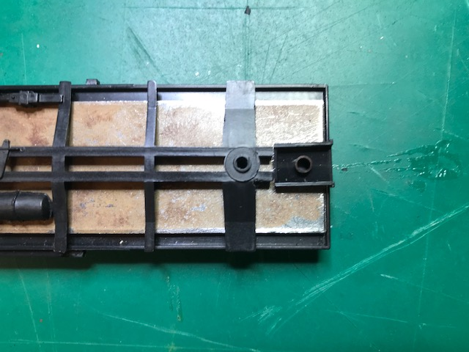
FINE-TUNING WITH KADEE
Positioning the Coupler Box.
It should be visually centered in the middle of the Frame.

Slide 21
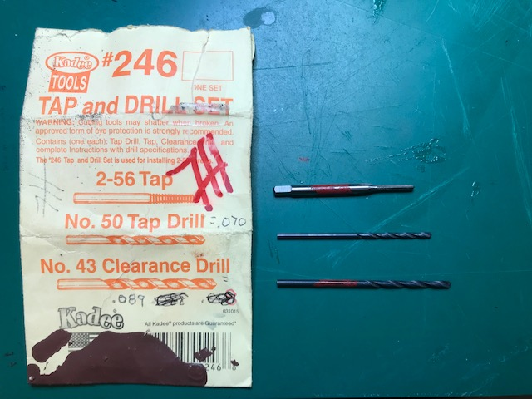
FINE-TUNING WITH KADEE
Make certain to use the #50 Drill Tap.
Otherwise , the hole will be too large.
It is the smaller of the two Drill Bits.

Slide 22
In place of the #43 Drill Bit you will have a nail with tape on it.

Slide 23
If using the #43 (The LARGER) Drill Bit, Place it perpendicular in the Coupler Pocket Hole. Then, While Keeping the Coupler Pocket in the Center of the Frame, Twist Clockwise until you create a dimple in the plastic floor.

Slide 24
If using the nail, place it perpendicular in the Coupler Pocket Hole. Then, while keeping the Coupler Pocket in the center of the Frame, push hard enough to create a dimple in the plastic Floor.

Slide 25
FINE-TUNING WITH KADEE
ACHTUNG!
We’re now ready to drill our Tap Hole through the plastic Floor.
It is IMPERATIVE that you use the correct Drill Bit.
It is the #50 (SMALLER) Drill Bit.
If you use the nail…it’s the only Drill Bit you have.
So remove the #43 Drill bit & replace it with the #50 Drill bit.

Slide 26
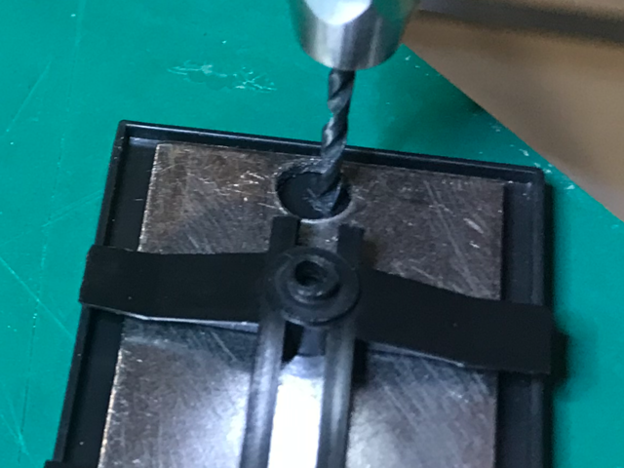
FINE-TUNING WITH KADEE
This picture demonstrates that while we are correctly lined-up in the center of the Frame, we are not in the center of the drilled/milled hole.
It is possible that on some cars both of these could coincide.

Slide 27
FINE-TUNING WITH KADEE
But, what happens if I mess up and don’t have the hole centered?
We’re going to replace the piece of the plastic glued to the Floor and add this small piece of plastic to cover up our mistake.
This will give us a foundation to drill a new hole.

Slide 28
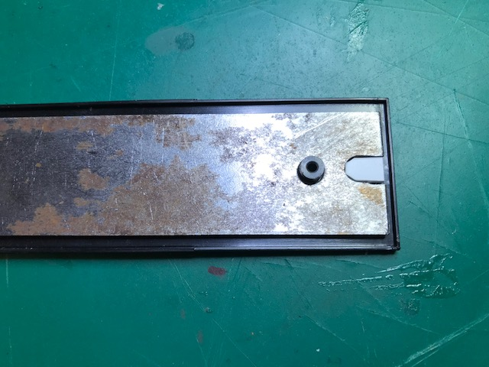
FINE-TUNING WITH KADEE
This small plastic insert will be glued to the bottom of the floor.
Now you can redrill your hole.

Slide 29
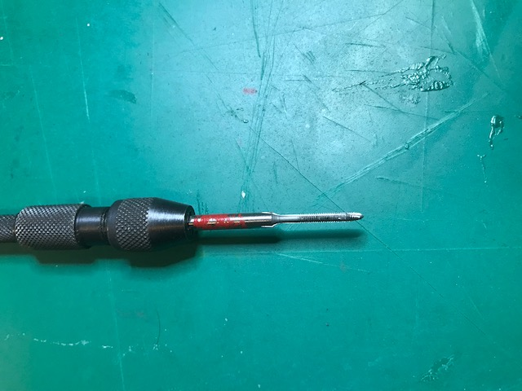
FINE-TUNING WITH KADEE
2-56 Tap in Pin Vise

Slide 30
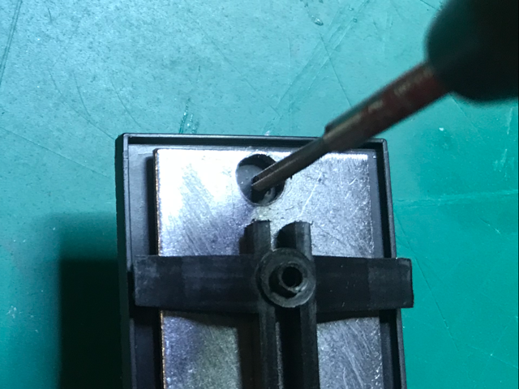
FINE-TUNING WITH KADEE
TAPPING
We now have to tap the hole
we have drilled so we can insert
a machine screw.
Place the Tap in the hole and
turn clockwise while applying
light pressure.
After a few turns the Tap will
self-feed.
Make sure to tap all the way
through the Floor and the
plastic glued to the other side of
the floor.
Turn counterclockwise to remove Tap.

Slide 31
FINE-TUNING WITH KADEE
Kadee #242 Box and #148 Coupler

Slide 32
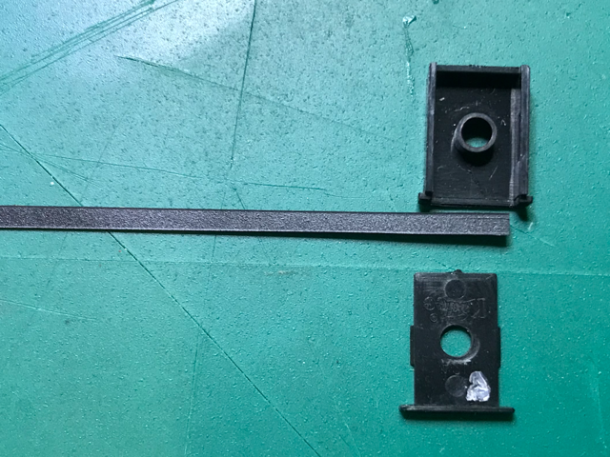
FINE-TUNING WITH KADEE
Shimming the Coupler Shank.
.010” Styrene Shim

Slide 33
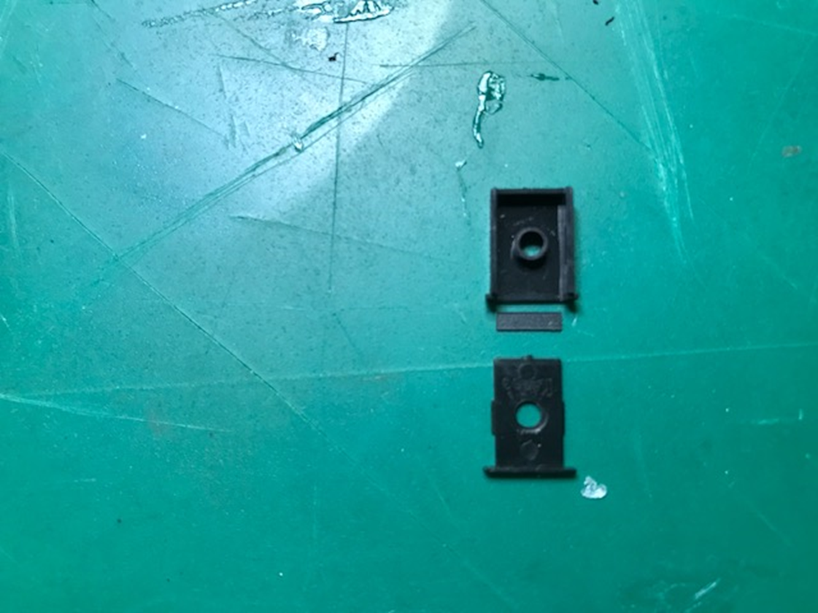
FINE-TUNING WITH KADEE
With your Exacto Knife, carefully cut the shim so it fits
inside the Coupler Box.

Slide 34
Application of Liquid Styrene Cement (A learning Curve)

Slide 35
Liquid Styrene Cement works through “Capillary Action”. This means that you use an applicator to apply cement to the plastic joint and allow the liquid to flow between the pieces.

Slide 36
Notice how we’ve moved the paint brush along the plastic joint, allowing the liquid to flow.

Slide 37
Lay out your 3 pieces of the Kadee #148 assembly as shown.

Slide 38
Place the Coupler in the Pocket with the Trip-Pin down.

Slide 39
Note that the Coupler Lid has “Kadee” printed on 1 side. This side MUST be facing outward or the Lid will not snap in place. Position the Lid on top of the opening, and with pressure, snap in place.

Slide 40
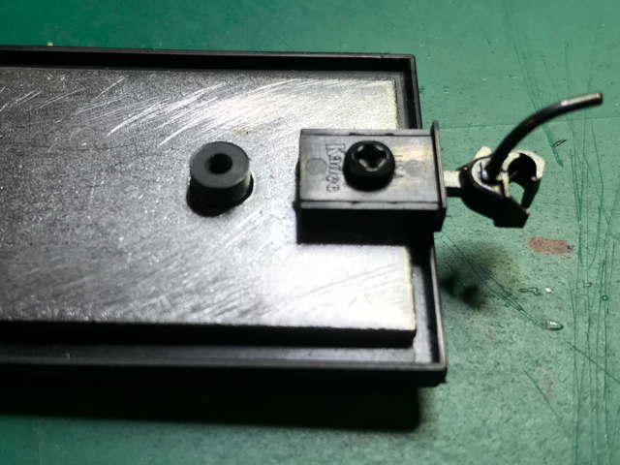
FINE-TUNING WITH KADEE
Use the #256 Screw to attach the assembled Coupler Box to the bottom of the Car Floor.
Do not overtighten the screw.

Slide 41
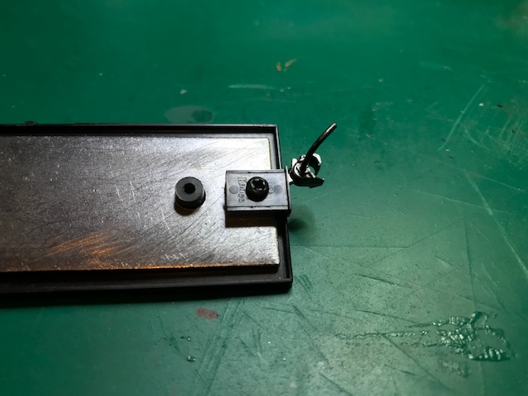
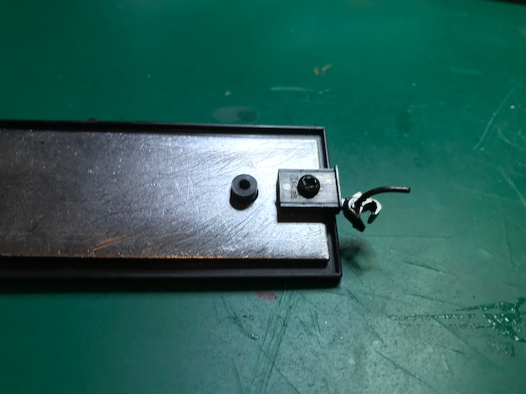
FINE-TUNING WITH KADEE
The Coupler should swing freely from side-to-side.
If the Coupler sticks at either end, the Mounting Screw is too tight.
Slowly back-off the Screw until the Coupler freely returns to center.

Slide 42
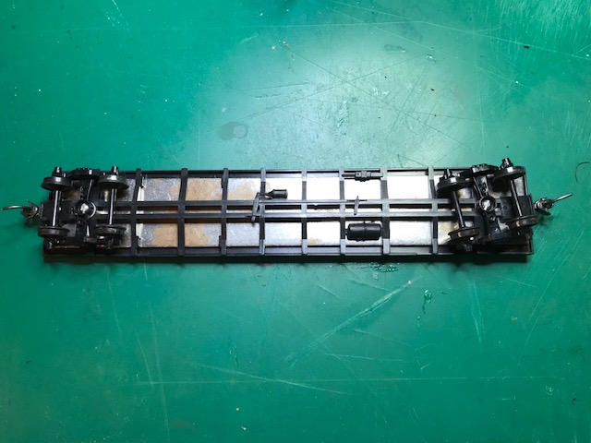
FINE-TUNING WITH KADEE
Install the Frame and the Trucks on the Car.

Slide 43
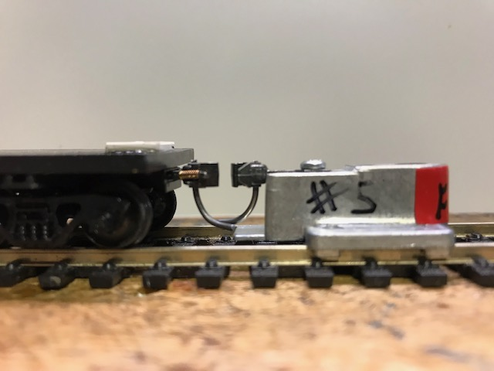
FINE-TUNING WITH KADEE
Now we’re going to check to see that the Coupler is at the correct height. We’ll also be checking the Trip-Pin clearance. Note that the Trip-Pin is just above the platform on the Coupler Gauge.

Slide 44
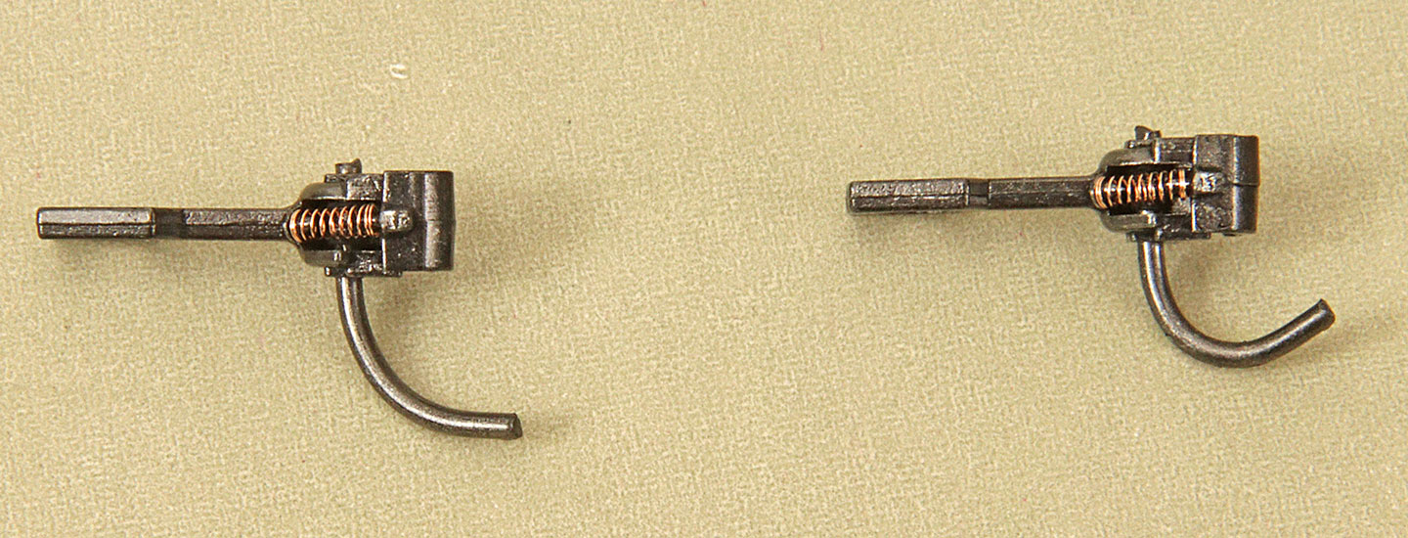
FINE-TUNING WITH KADEE
Trip Pins
Trip Pins are factory set.
You should not need to bend the trip pin if your coupler is mounted correctly.
If you think you need to bend the trip pin, you probably have the coupler mounted at an incorrect height.
Fine tune your coupler mounting height.
Correct Trip Pin Trip Pin that is now not going to function correctly because of bending.

Slide 45
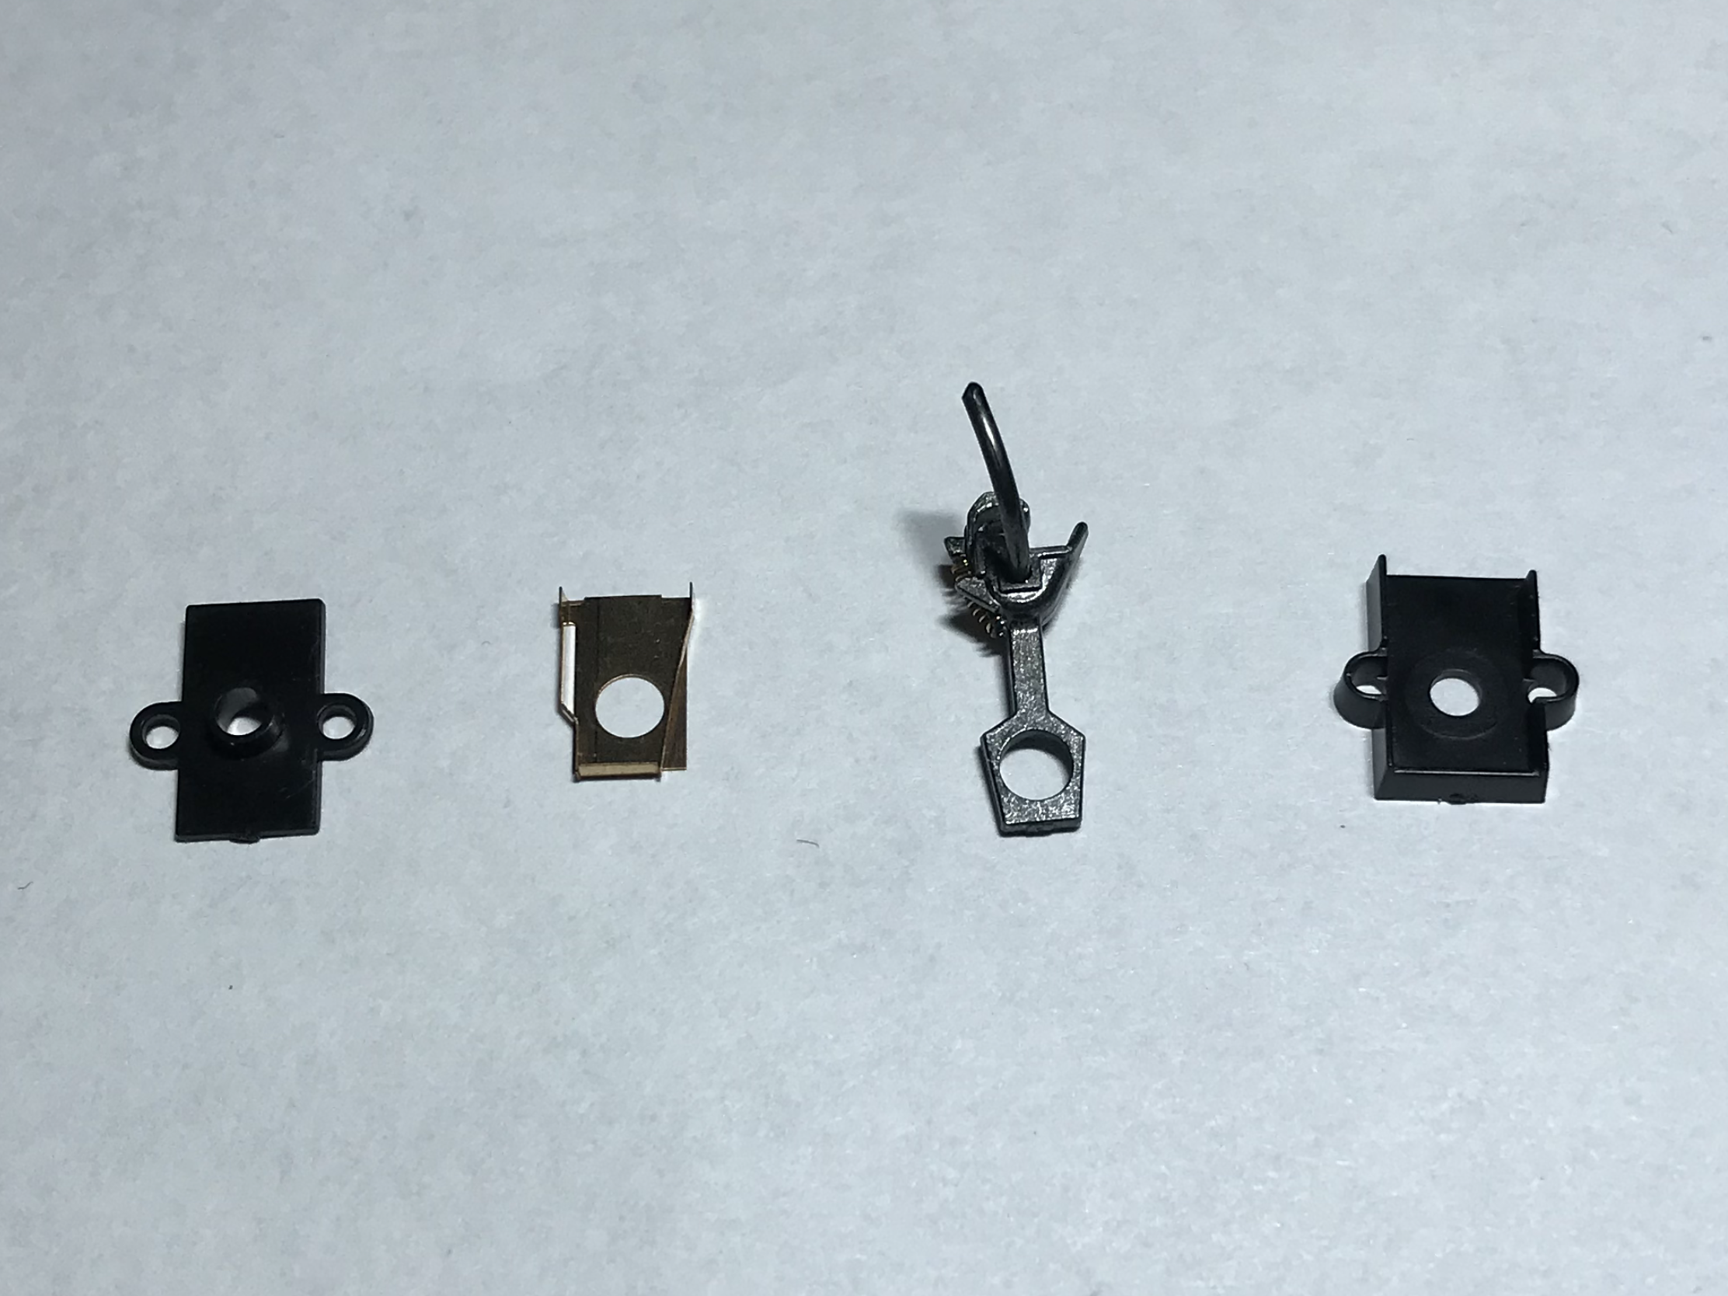
FINE-TUNING WITH KADEE
Assembling the Kadee #5 in a #232 Box.
Lay out the 4 parts in this order.

Slide 46
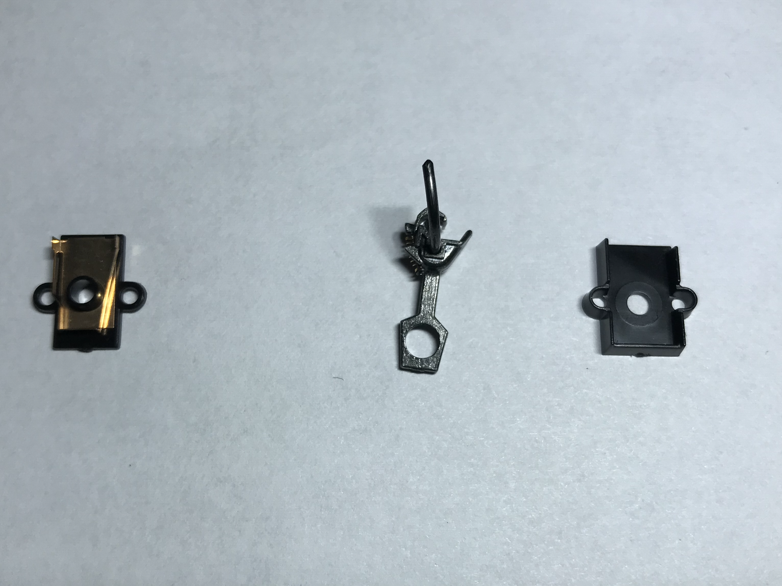
FINE-TUNING WITH KADEE
Place the Bronze-Phosphor
Spring in the Coupler Box.
The Bronze-Phosphor
Spring should always be above
the Coupler so that the
Coupler will center itself.
Then place the Coupler in the
Box with the Trip Pin pointing
up.

Slide 47
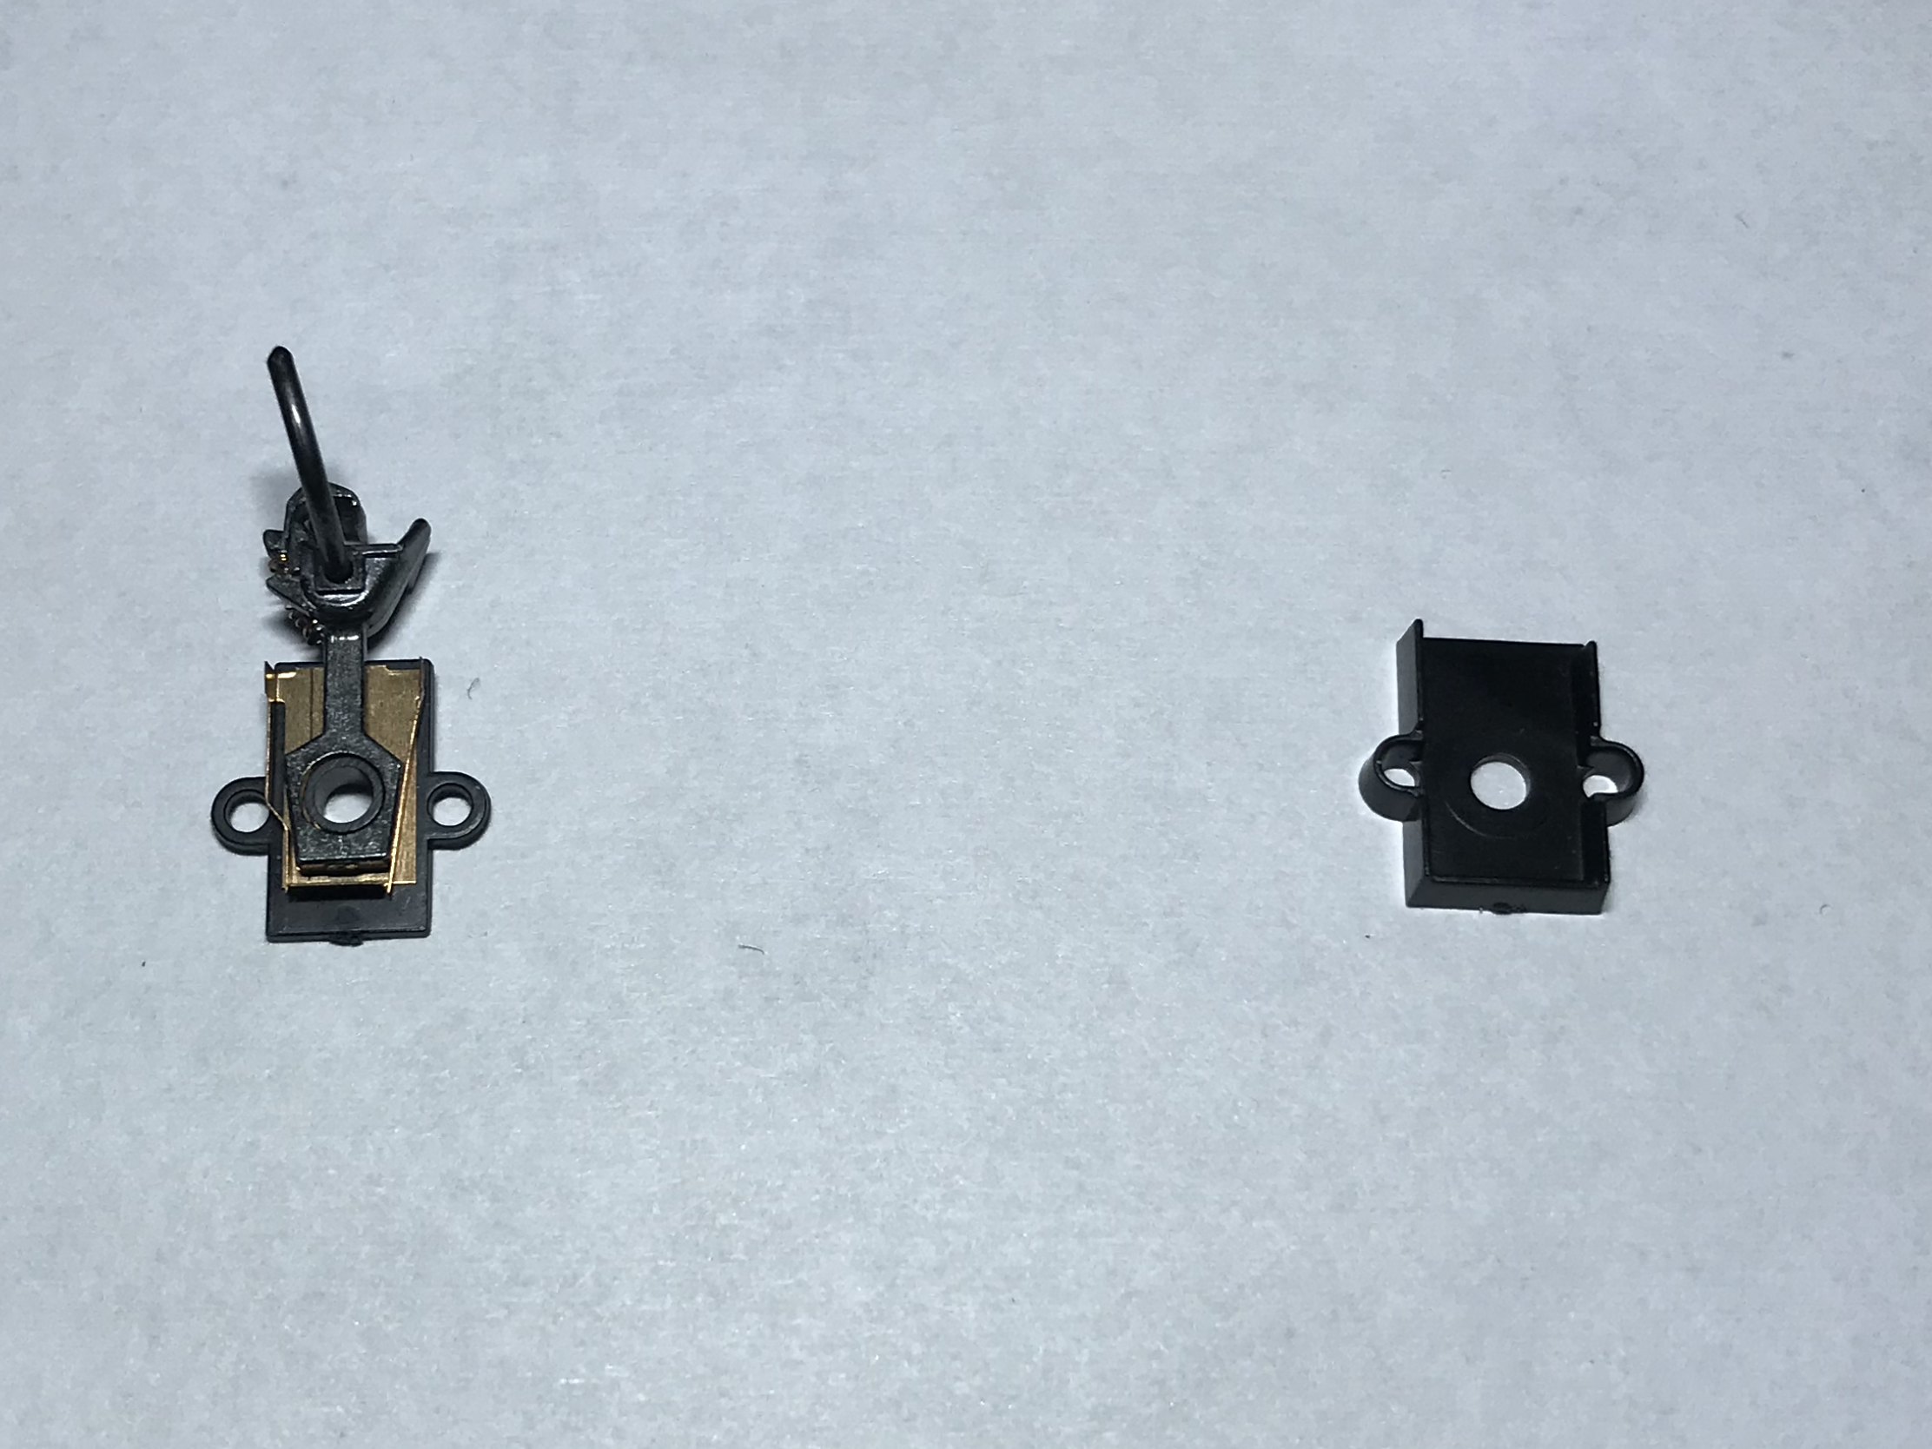
FINE-TUNING WITH KADEE
Correct orientation of the Kadee #5 Coupler and Box,
but without Shim installed. You can now put the Coupler Lid on.
The lid on the #232 Box does not snap on.

Slide 48
Without a snap-on lid you must hold the Coupler together. Note that this Coupler droops.

Slide 49
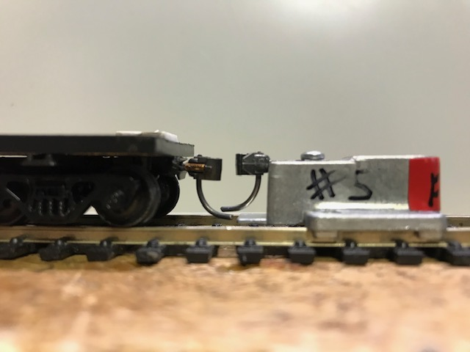
FINE-TUNING WITH KADEE
Without the Shim inside the Coupler Box the #5 Kadee Coupler has some vertical “play”, causing it to droop. Many people will accept this.
They should not because:
The Trip-pin is too low
and will cause a derailment.
When the train goes up a
grade it will likely
uncouple.

Slide 50
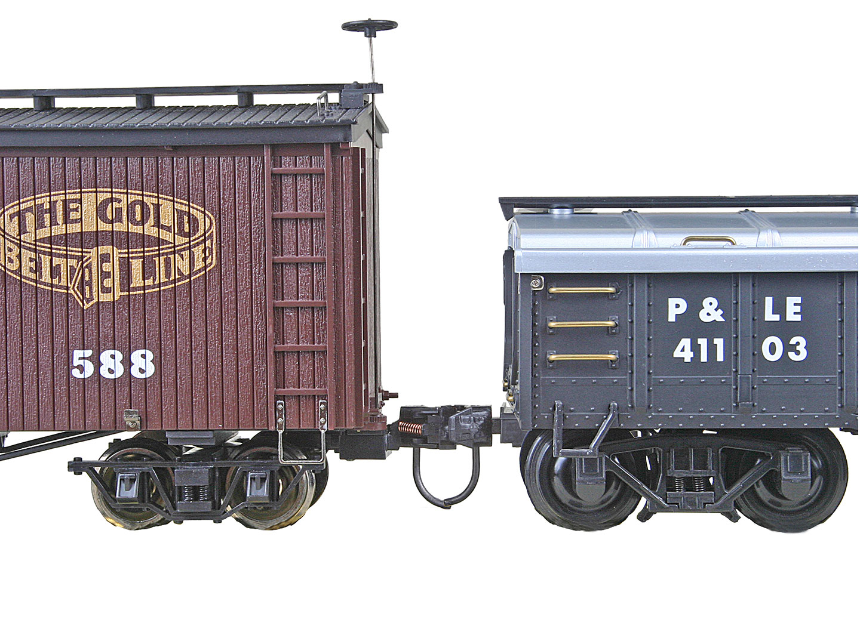
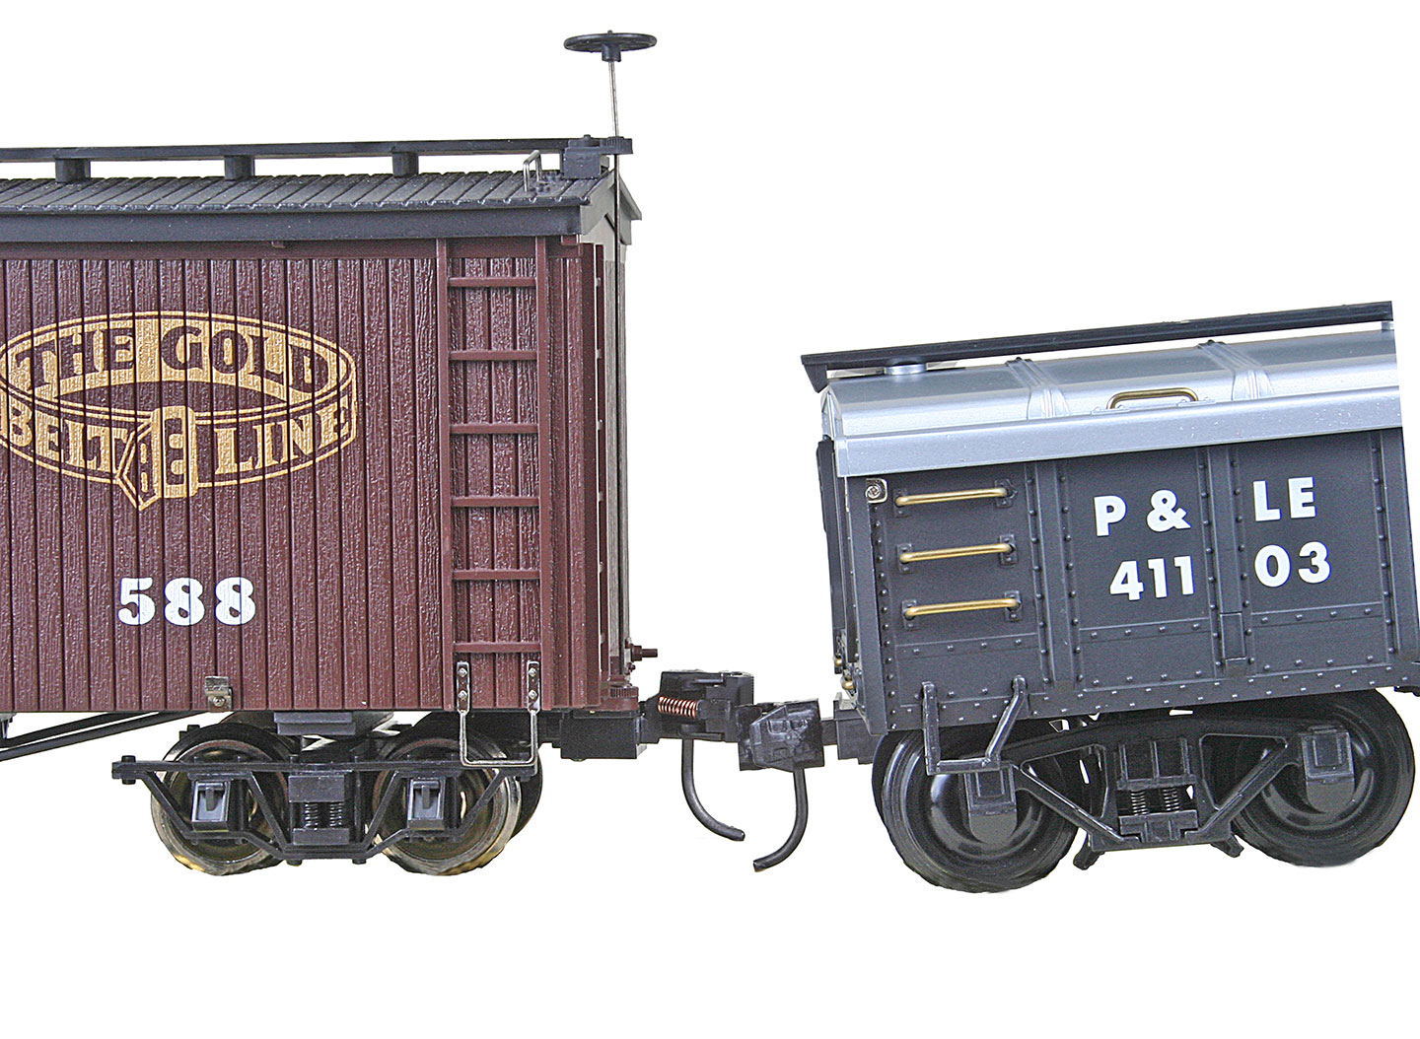
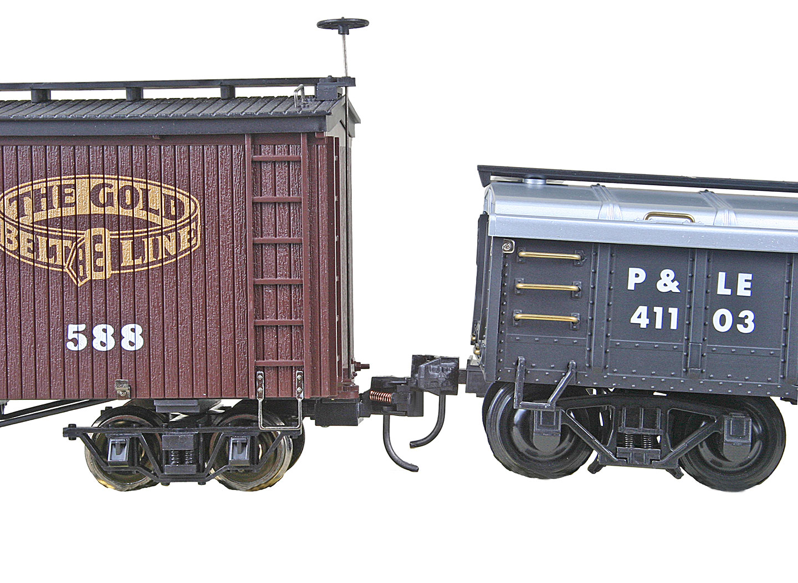
FINE-TUNING WITH KADEE
Coupler Knuckles Move Up and Down
When going over rough track or transitions
Normal Pulling Coupler slips down Coupler slips up from from starting up a starting down a grade grade or a dip in or a hump in the track the track

Slide 51
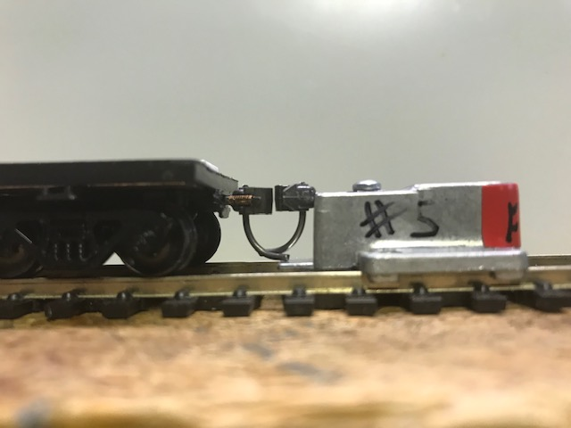
FINE-TUNING WITH KADEE
This is what our Coupler looks like after the .010” Shim has been installed inside the Couple Box. Close, but we can do a touch better.

Slide 52
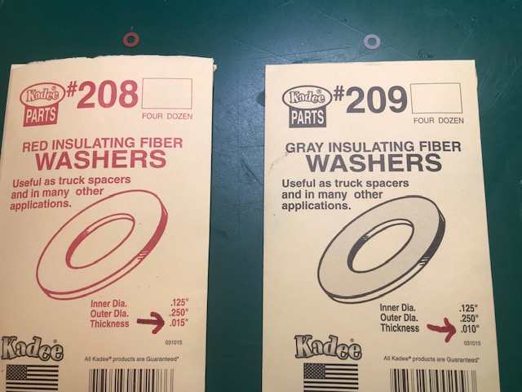
FINE-TUNING WITH KADEE
These are Truck Spacers. They come in two sizes:
.015”, a red washer .010”, a gray washer

Slide 53
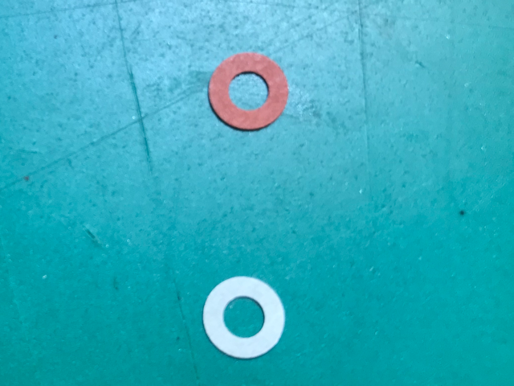
FINE-TUNING WITH KADEE
These washers can be placed between the Bolster and the Truck (Wheel Assembly).
This will incrementally raise the height of the Coupler.

Slide 54
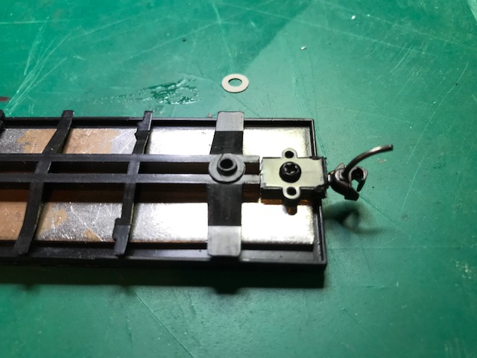
FINE-TUNING WITH KADEE
Bolster & .010” Washer

Slide 55
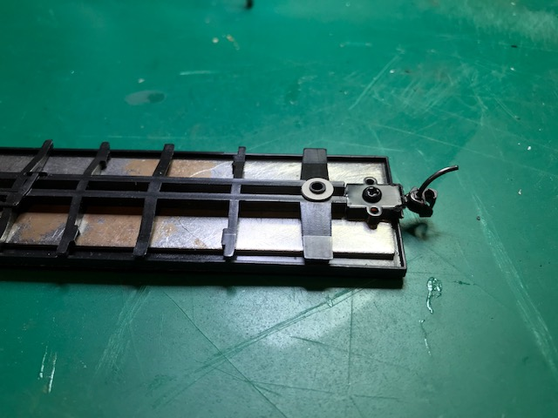
FINE-TUNING WITH KADEE
Bolster & .010” Washer installed.

Slide 56
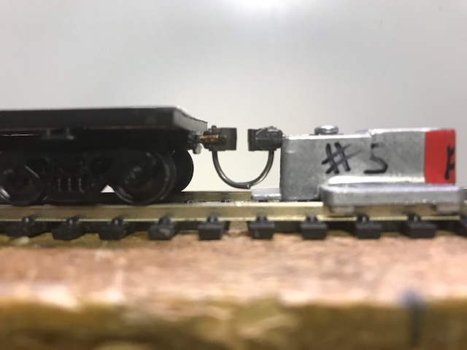
FINE-TUNING WITH KADEE
This is what it looks like uncoupled when you get it right.

Slide 57
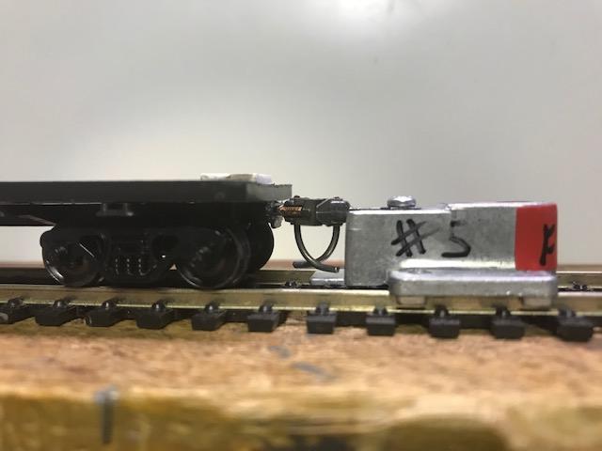
FINE-TUNING WITH KADEE
This is what it looks like when you get it right.

Slide 58
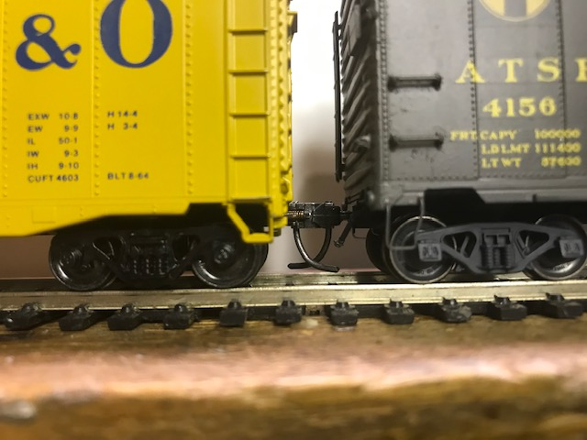
FINE-TUNING WITH KADEE
This is what it looks like when you get it right.

Slide 59
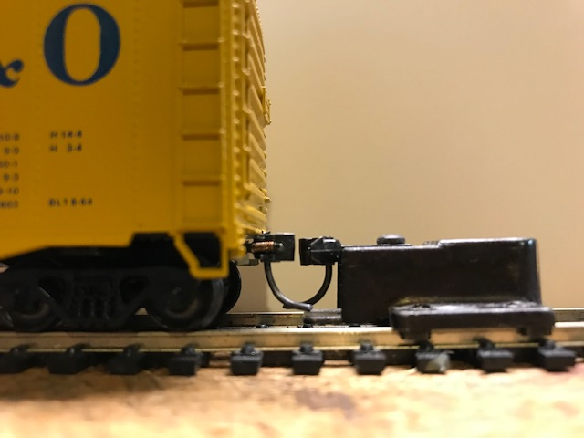
FINE-TUNING WITH KADEE
But what happens when the Coupler is too high?
You might be tempted to accept this. You should not.

Slide 60
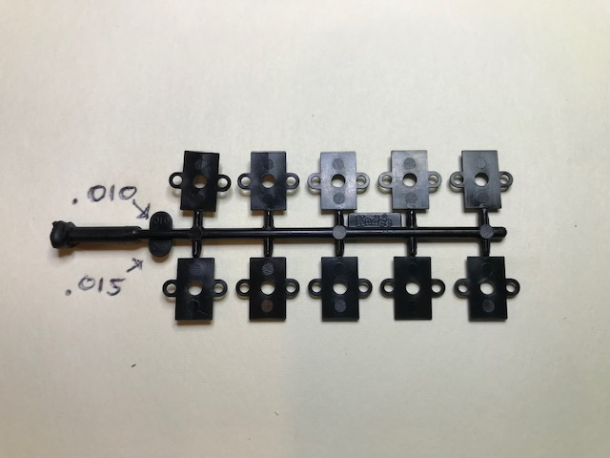
FINE-TUNING WITH KADEE
These are Kadee #211 Shims. One package contains both .010” and .015” Shims. Unlike the washers, they are not color coded.
These will be place between the Car Body and the Coupler, lowering the height of the Coupler.

Slide 61
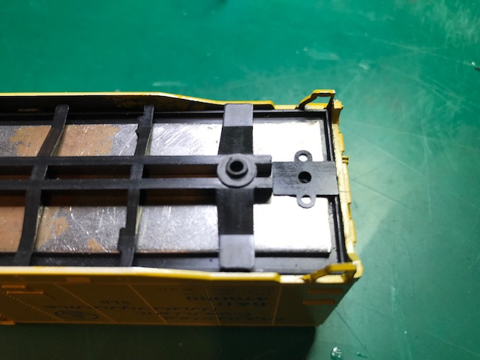
FINE-TUNING WITH KADEE
This is a visual of the placement of the Shim on the Car Body.
With the Shim in place, re-install the Coupler Box and #2-56 Screw.

Slide 62
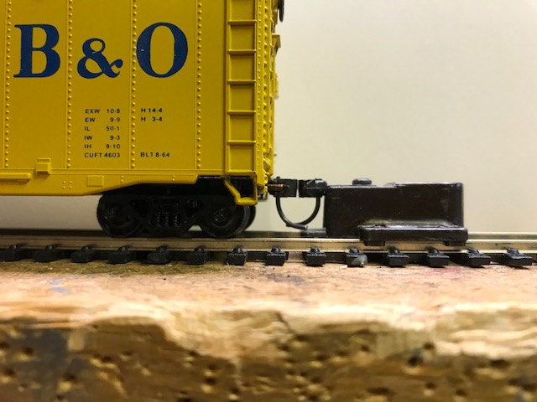
FINE-TUNING WITH KADEE
Use the Coupler Height Gauge to check your work.

Slide 63
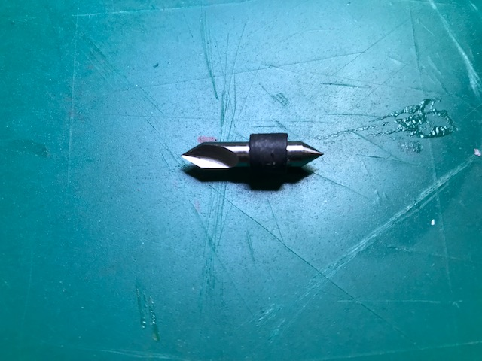
FINE-TUNING WITH KADEE
This HO Truck Tuner comes in handy when you have axles that don’t turn freely in the Truck.
It is available from Micro-Mark, part #82838.

Slide 64
FINE-TUNING WITH KADEE
Insert the HO Truck Tuner between the Side Frames. With light pressure on the Side Frames, slowly turn the Truck Tuner to remove any burrs. Reverse the Truck Tuner and repeat on the opposite side.

Slide 65
A correctly weighted car will operate much better than a car that is too light. A scale 40’ car is about 6” long and should weigh 4 ounces. A scale 50’ car is about 7” long and should weigh 4.5 ounces. This car was light and weight was added to it.

Slide 66
A good way to add weight to a flat car, hopper car, or gondola is to add a load.

Slide 67
FINE-TUNING WITH KADEE

Slide 68
FINE-TUNING WITH KADEE
Between-the-rails Under-the-track Electric Uncoupler
Uncoupler Uncoupler
Manual Uncoupling Tool

Slide 69
FINE-TUNING WITH KADEE
SPECIAL THANKS TO KADEE FOR IT’S CONTRIBUTIONS TO THIS CLINIC.
Be sure to visit them at:
The Better Living Center
Booth #39

Slide 70
FINE-TUNING WITH KADEE

